Slide 1

DIGITAL TECHNOLOGY IN TOURISM
BY KTC HUBLI
GROUP 3:
SHANKAR R
VINAYA
TABREZ
GURUPRASAD
KAIWALYA K
GUIDED BY:
MOHAMMAD TAHIR MIRJI
L2 Trainer KTC Hubli
Case study for
Expert : Soumyajit Dey

Slide 2
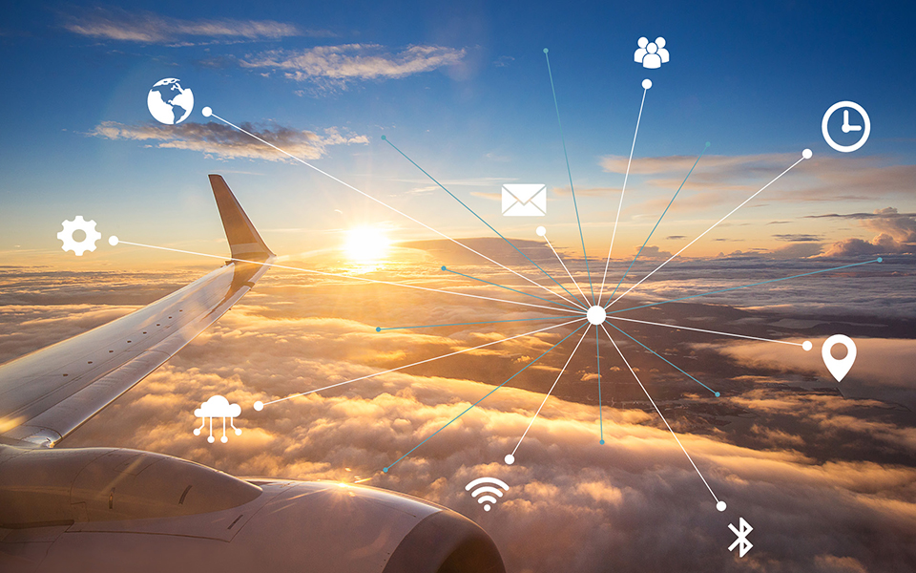
INTRODUCTION TOURISM
Digital technology plays a critical role in the tourism industry
The travel and tourism industry is the world's largest and most diverse industry.
Many nations rely on this dynamic industry as a primary source for generating revenues, employment, private sector growth, and infrastructure development.

Slide 3


What is the role of digital technology in tourism :-
Online bookings: Digital technology has made it easier for tourists to book their trips online, from flights and accommodations to activities and tours.
Mobile apps: Tourism companies can develop mobile apps to provide information to tourists on local attractions, weather, and transportation. These apps can also provide real-time updates on local events, attractions, and activities.

Slide 4


Virtual tours: Virtual tours can give potential tourists a glimpse of what they can expect during their visit and allow them to explore destinations before they arrive.
Sustainable tourism: Digital technology can be used to promote sustainable tourism practices by reducing paper waste, promoting recycling, and encouraging the use of public transportation

Slide 5
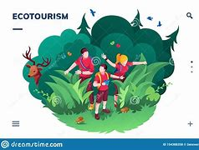
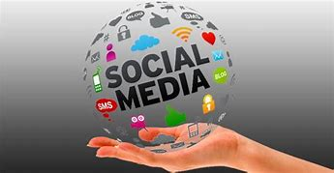
How will you use tech to promote ecotourism:-
Develop an eco-tourism app: Create an app that lists eco-friendly destinations, activities, and accommodations. This will allow users to easily find and book eco-tourism experiences.
Use social media: Use social media platforms like Instagram, Facebook, and Twitter to promote eco-tourism initiatives and share information about eco-friendly destinations and activities.

Slide 6

Offer virtual eco-tours: Develop virtual eco-tours that allow people to explore eco-friendly destinations and learn about conservation efforts.

Slide 7
How will you use data and analytics to improve the current state of tourism :-
Collect data: Collect data on tourist behavior, such as travel patterns, destination preferences, and spending habits. This data can be used to create customized travel experiences and to better understand the needs of tourists.
Analyze data: Analyze the data collected to identify trends, preferences, and patterns. This will help to develop more targeted marketing campaigns and improve the quality of tourism experiences.
Use data to optimize operations: Use data to optimize tourism operations, such as transportation and accommodations. This

Slide 8
What will be your business plan :-
Develop an eco-tourism app that provides information on eco-friendly destinations, activities, and accommodations.
Create a social media marketing campaign that promotes eco-tourism initiatives and shares information about eco-friendly destinations and activities.
Collect and analyze data on tourist behavior to create customized travel experiences and improve the quality of tourism experiences.
Develop partnerships with eco-tourism companies and organizations to promote sustainable tourism practices.
Offer virtual eco-tours to promote eco-friendly destinations and conservation efforts.
Develop a loyalty program to reward customers for choosing eco-friendly tourism experiences.
Continuously monitor and improve the customer experience to ensure satisfaction and loyalty.

Slide 9
conclusion
In conclusion, digital technology has transformed the tourism industry and has the potential to drive sustainable tourism practices. By leveraging data and analytics, we can improve the current state of tourism and create a positive impact on the environment and local communities. Our business plan aims to promote eco-tourism and provide travelers with unique and authentic travel experiences. Let's work together to create a sustainable future for tourism.

Slide 10


